Slide 1
LCS Administration for Dynamics 365 For Finance and Operations Implementations

Slide 2



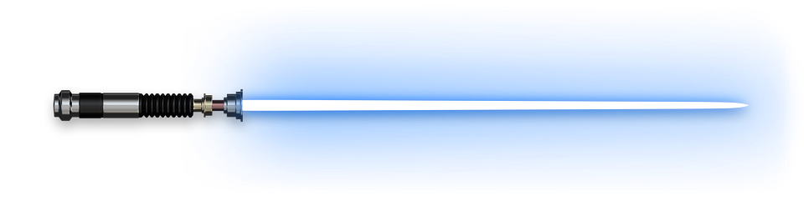
Speaker Blog
Nathan Clouse
Technical Solution Architect
MCA Connect, LLC
AXUG Summit Track Leader 2018/19
Nathan.clouse@mcaconnect.com
www.atomicax.com
@NathanClouseAX

Slide 3

Topics
Overview
Environments
Topologies and Tiers
Azure
Development
Management
Tools
Notes:
Candy and trivia
What were Luke's aunt and uncle's job on Tatooine? moisture farmers

Slide 4
Overview

Slide 5
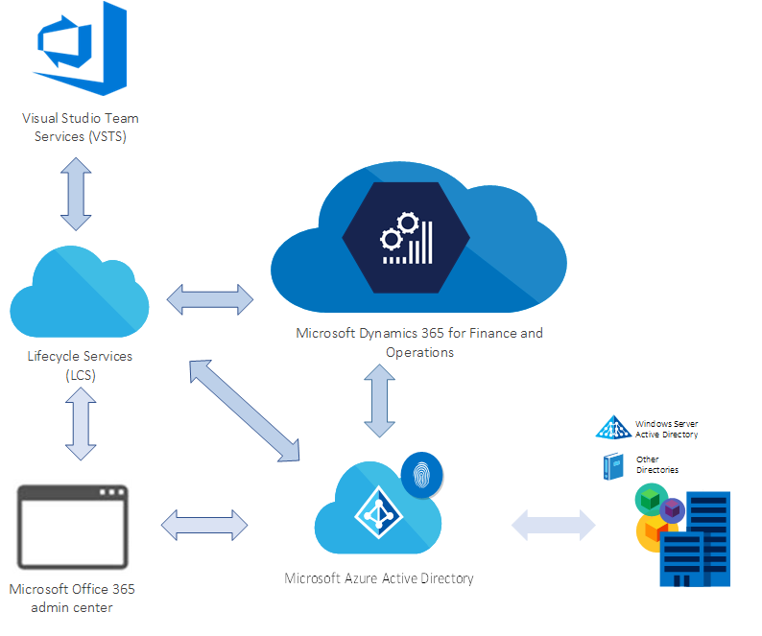
Overall Solution for D365FO

Slide 6
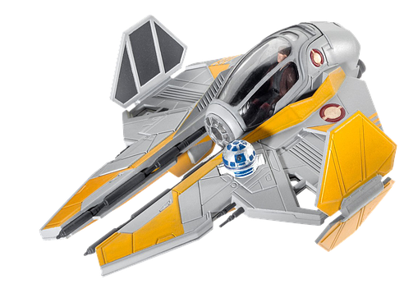
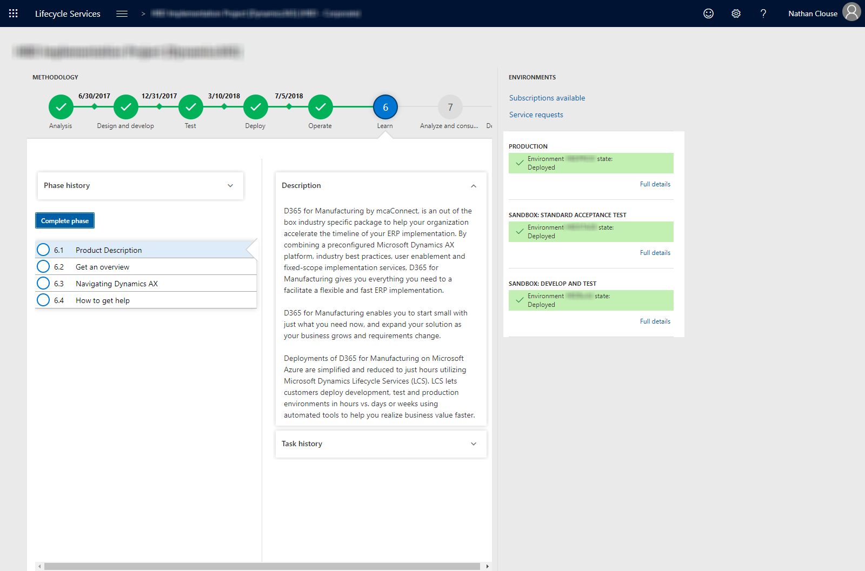
LCS Look and Feel - Cloud
Notes:
What LCS looks like for the cloud

Slide 7
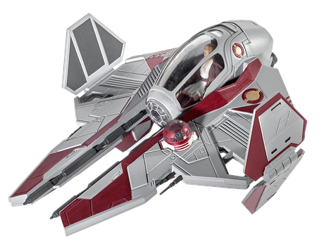
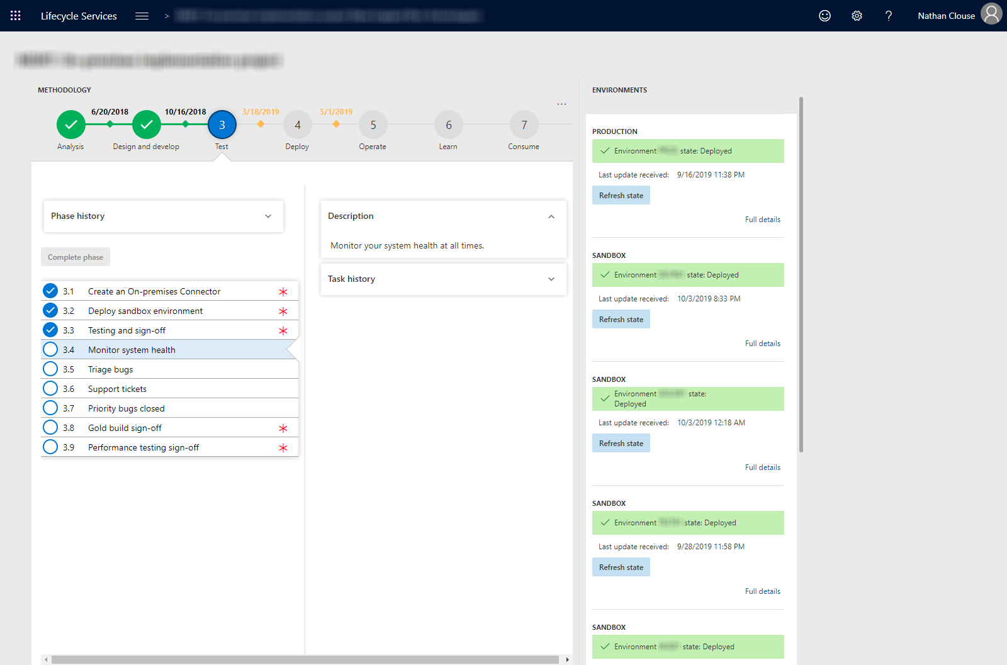
LCS Look and Feel – On Premise
Notes:
LCS look for on prem
In how many languages is C-3P0 fluent? more than 6 million

Slide 8
Environments

Slide 9
Topologies

Slide 10
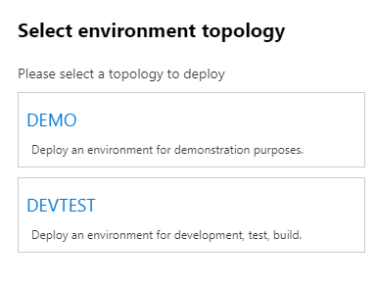
What is a topology?
Describes the composition of the environment
Develop
Build and Test
Standard Acceptance Test
Demo
Operations (Production)

Slide 11
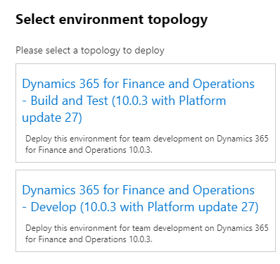
What is an environment purpose?
Why it exists – what it is for
Development
System Test
UAT
Performance Test
Training
Operations

Slide 12
What is a tier?
Describe the scale or size of the environment
Tier 1 – 5
1 is the smallest
5 is the largest
Sizing to tier is relative and does not translate to exact number of specific with specific roles
I.e.; T5 could be 20 or 50 AOS servers
Sizing worksheet (Don’t forget it)
Notes:
who actually shot first? han solo

Slide 13
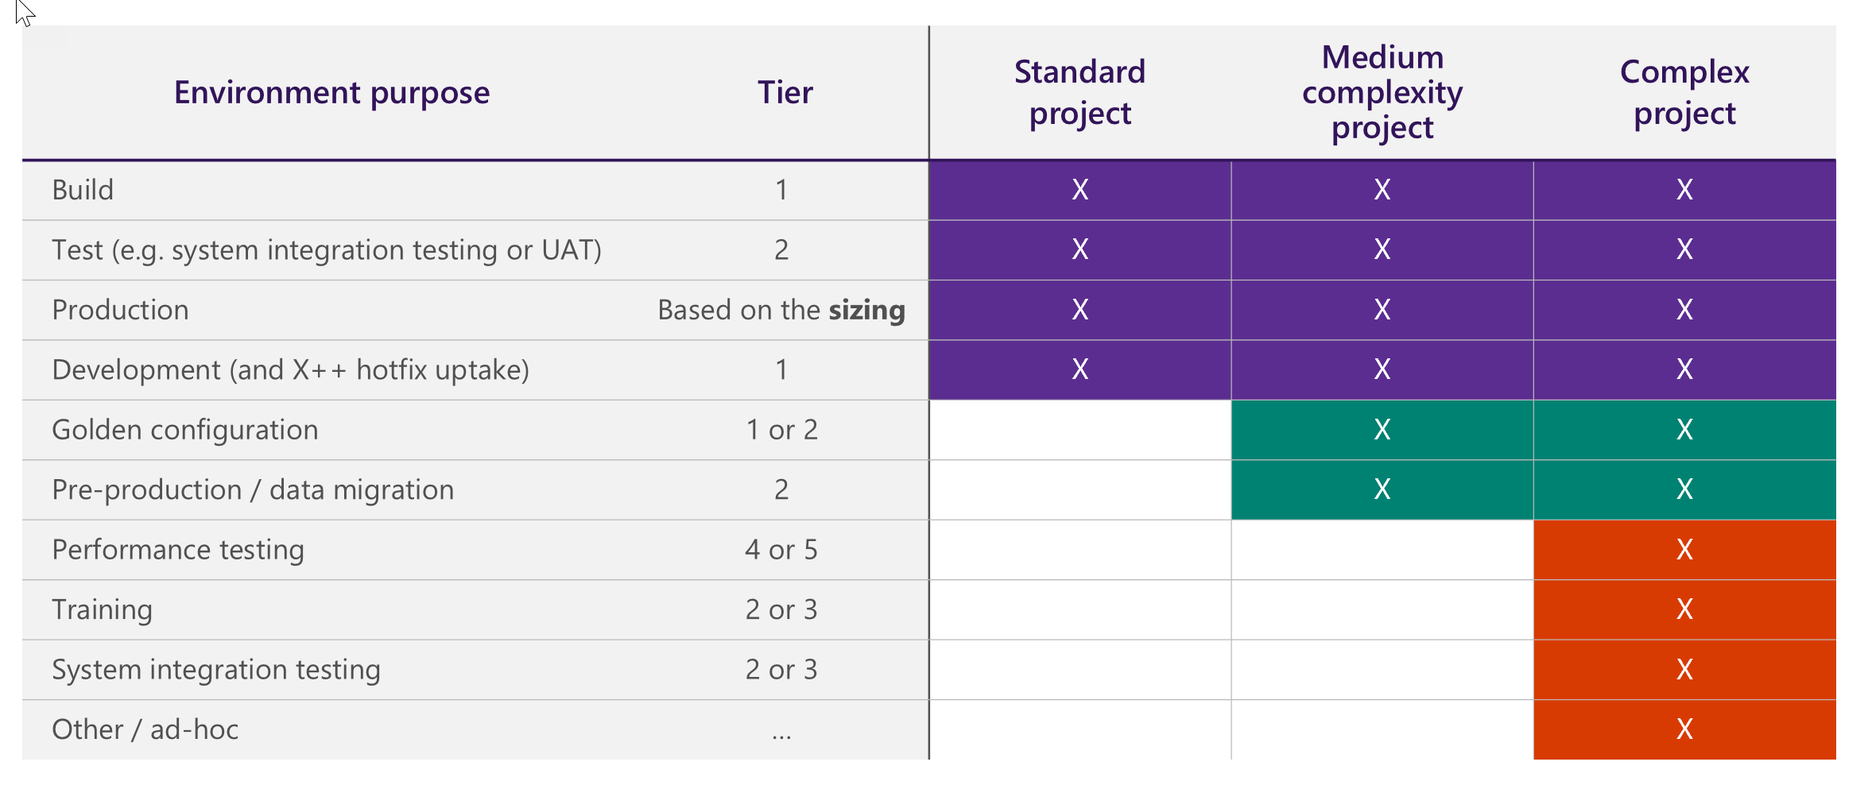
Tier Chart

Slide 14
What is an environment type?
Standard
This environment is included in the standard offer and is managed by Microsoft in a Microsoft subscription. Standard environments include the production environment, a Tier-2 Standard Acceptance Test environment, and one Tier-1 develop and test environment. No separate Azure billing.
Add-On
The add-on environments are in a Microsoft-managed subscription that the customer has purchased in addition to the standard offer. For example, an add-on environment might be an additional Tier-4 environment for performance testing. Additional SKU with no separate Azure bill.

Slide 15
What is an environment type? (cont.)
Cloud-Hosted
additional environments that are managed by the customer or partner in a customer or partner Microsoft Azure subscription. A cloud-hosted environment can include a Tier-1 demo environment. No additional SKU but has separate azure bill.
Environment Image (VHD)
additional Tier-1 environments are hosted on-premises by using a virtual hard disk (VHD) that can be downloaded from Microsoft Dynamics Lifecycle Services (LCS). Can be hosted locally on your laptop/desktop or your data center. Can be converted to other virtualization platforms and duplicated for multiple develops

Slide 16
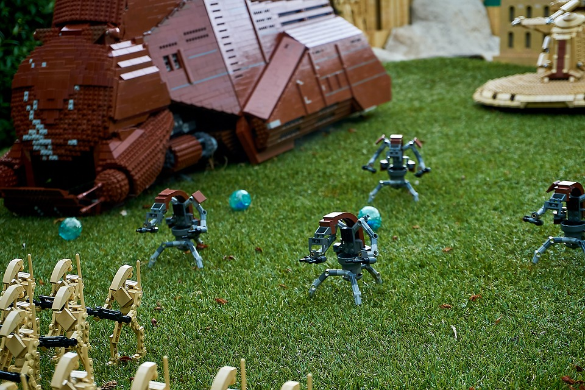
Available Topologies
Develop for T1 “Onebox”
Build and Test for T1 “Onebox”
Sandbox for T2+
Operations for T2+
Notes:
what type of droid is R2D2 classified as? astromech droid

Slide 17
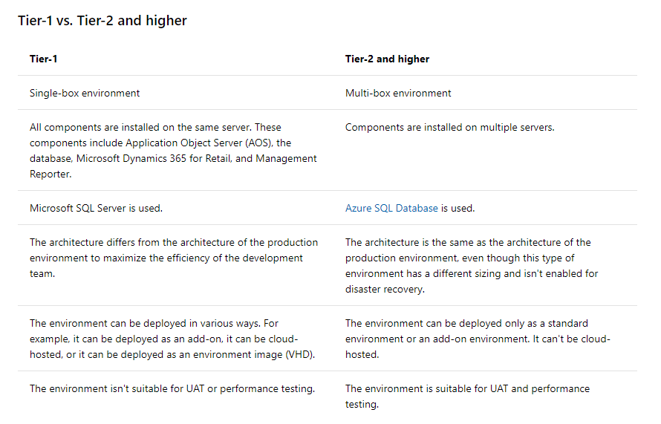
Major Tier Differences

Slide 18
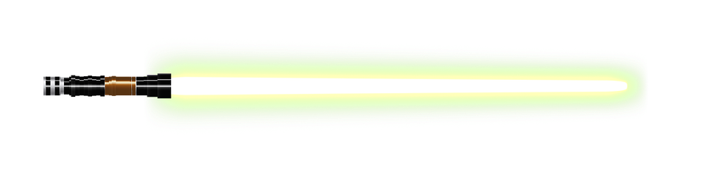
Design Time vs Run Time
Design time
Has source code
Can develop here
Easy to debug
Runtime
Has binaries from code – compiled code
Cannot develop here but better performance
Can debug but not as easy – can be involved

Slide 19
Azure

Slide 20
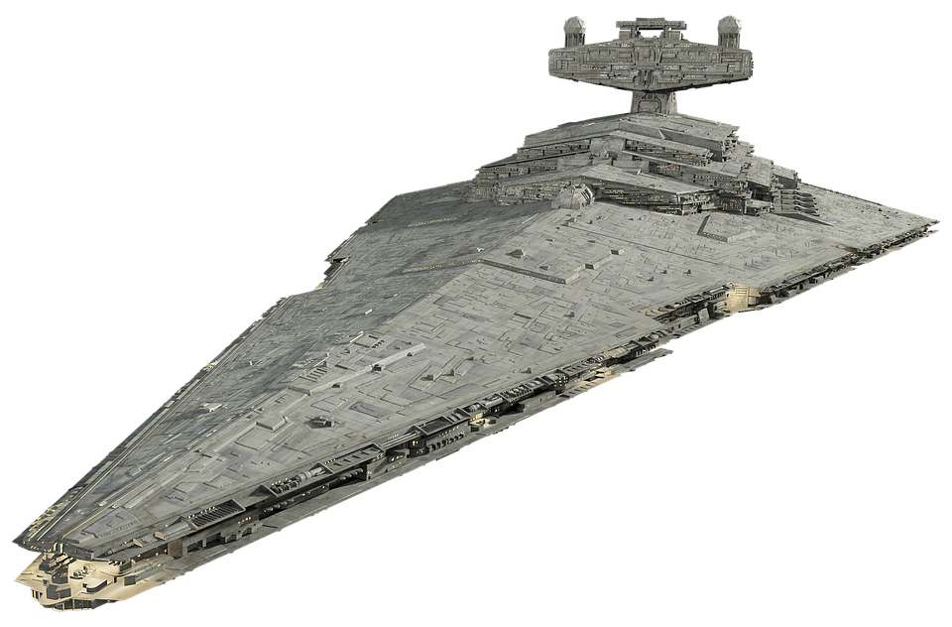
The cloud costs money
Reduce waste
Size appropriately
Easy to over size to review periodically
Allocate machines to individuals
If for development, make them a contributor on that machine so they can manage its uptime
Use Tags in the Azure Portal

Slide 21
Schedule
Auto Shutdown
You can set auto shutdown times with email to webhook messages – send those to the assigned person
Start and Stop Scripts
Start and stop VMs are specific times
MSFT provides a tool to do this that requires some setup
Others have a free/paid service to help
Skyplug.io
VMPower.com

Slide 22
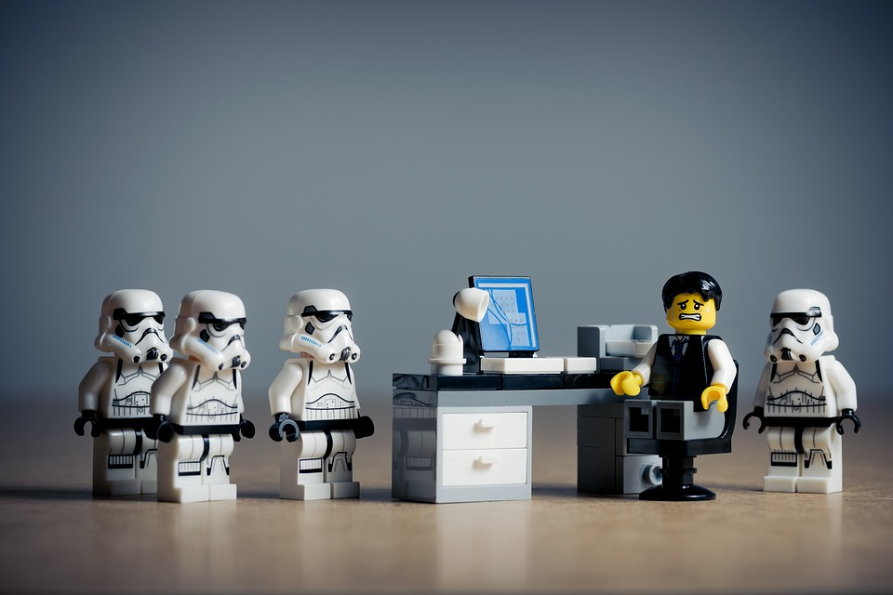
“Gotchas”
Shutdown does not mean no longer billing
Shutdown and deallocated means no longer billing
Managing availability and cost
Less about infrastructure
Notes:
THE MILLENNIUM FALCON, CAN COMFORTABLY FIT HOW MANY PEOPLE IN THE COCKPIT? Four

Slide 23
Provisioning

Slide 24
Provisioning
Orchestration of all environments, cloud or otherwise, is done though Life Cycle Services, or LCS.
https://lcs.dynamics.com
Use a generic account, like dynadmin@domain.com for management
Dynamics Service Engineer team commonly just called DSE.

Slide 25
By Type
Standard
Standard environments are managed via LCS. You create a request for the environment to be created which is then fulfilled and completed by DSE
Add-On
Same as standard after purchase and addition to LCS project.
Cloud Hosted
Entirely self-service.
On your Azure Subscription, LCS just orchestrates
All VMs created in a resource group for that VM
Can be on the same vNet if you want
Notes:
Standard
Standard environments are managed via LCS. You create a request for the environment to be created which is then fulfilled and completed by DSE (Dynamics Service Engineer) team commonly just called DSE.
Add-On
Same as standard after purchase and addition to LCS project.
Cloud-Hosted
Entirely self-service. Once you connect your LCS project to your Azure Subscription, you run through a wizard to create the VM and it submits the request to create that VM on your subscription with the specific options. If a new azure sub, request your core count be increase before provisioning your first VM. All VM resources are created in a resource group for that VM.

Slide 26
By Type (cont.)
VHD
Download from LCS. Go to hamburger > asset library > Downloadable VHD Files, import each part of the version you want, download each file individually, unpack, open in Hyper V.
Production / Operations
Submit a request to DSE with your subscription estimation worksheet complete. Request will be reviewed and approved. MSFT may request additional info or provide feedback on your request.

Slide 27

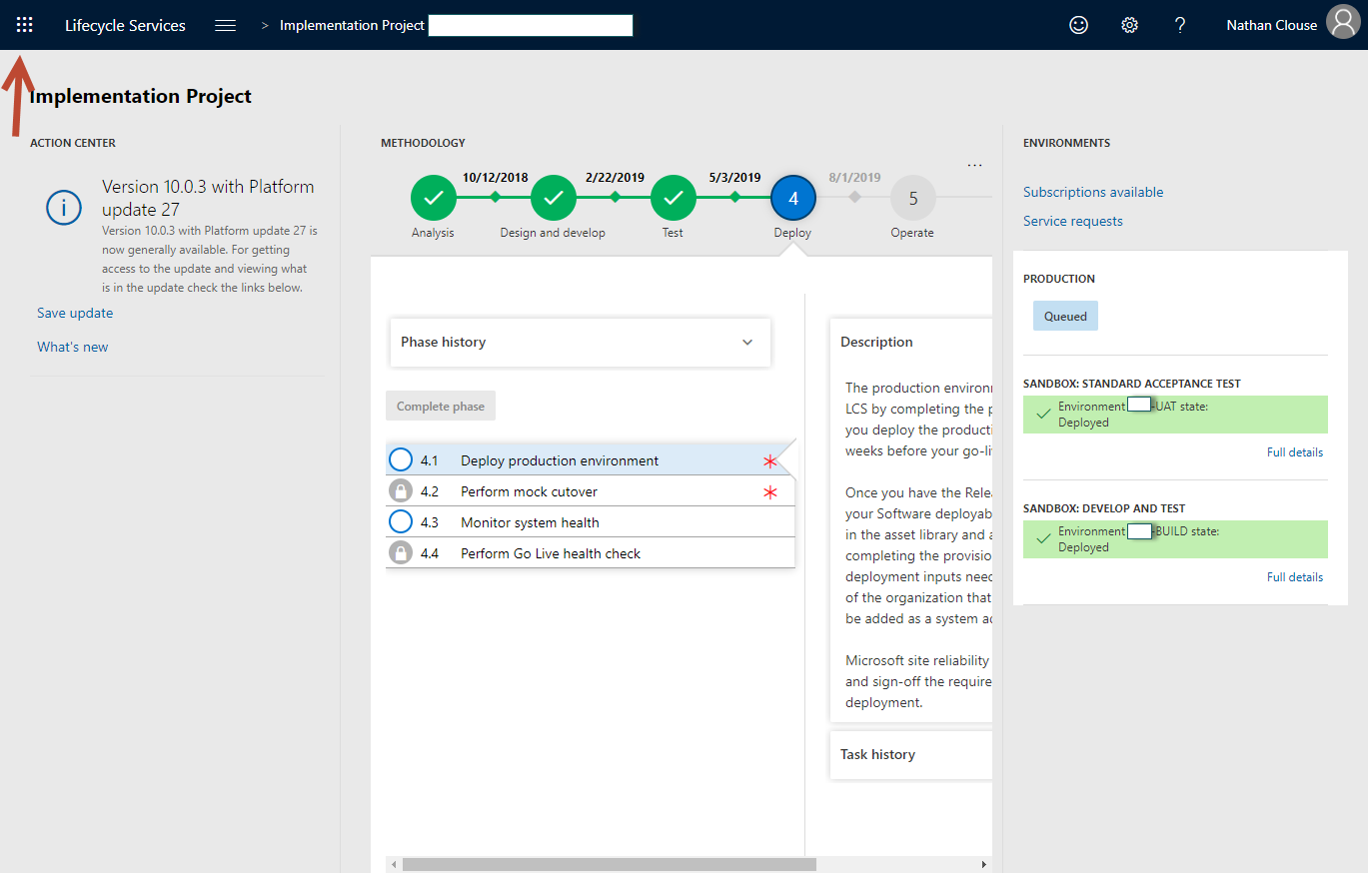
Waffle

Slide 28
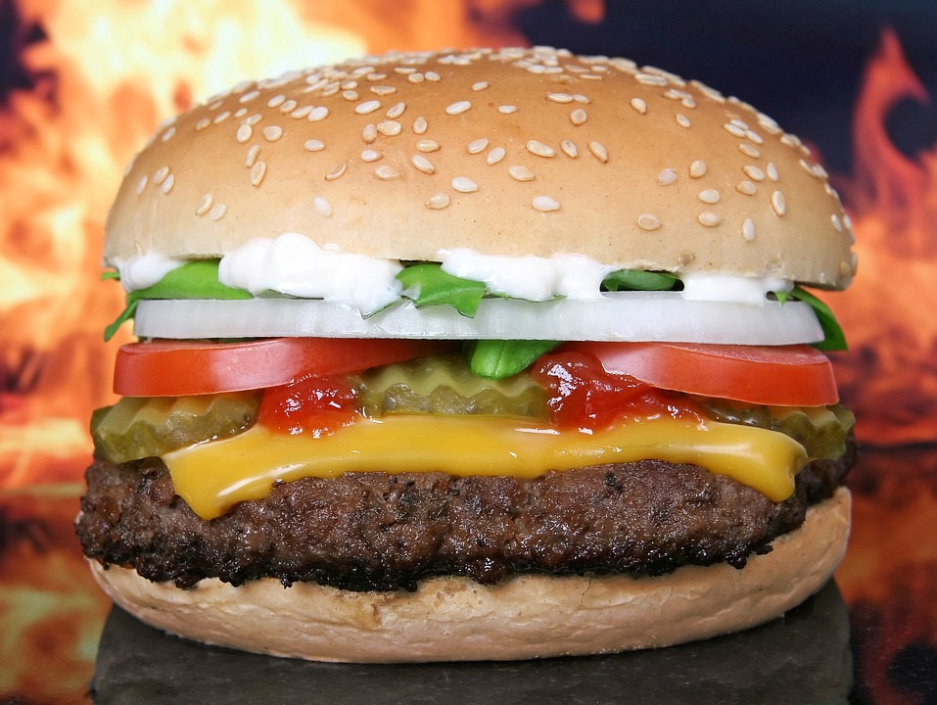
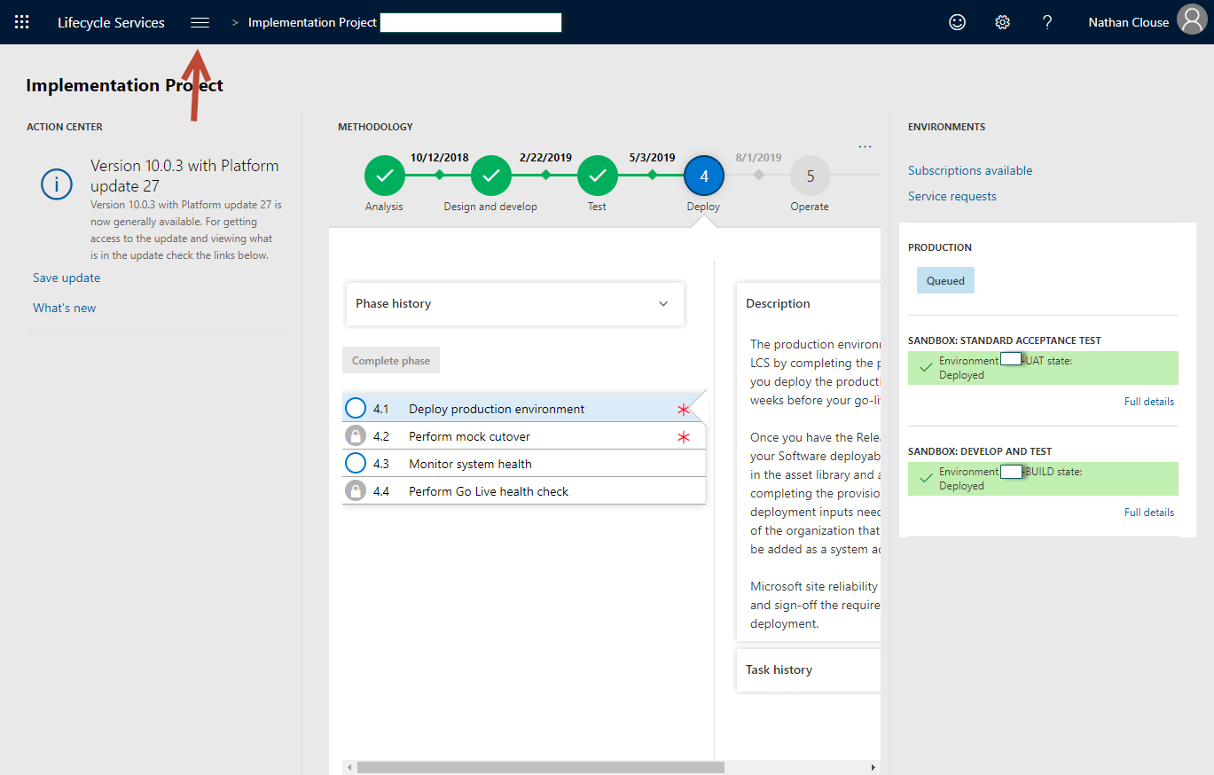
Hamburger
Notes:
ADMIRAL RADDUS AND ADMIRAL ACKBAR BOTH HAIL FROM WHICH PLANET? mon cala

Slide 29
Servicing

Slide 30
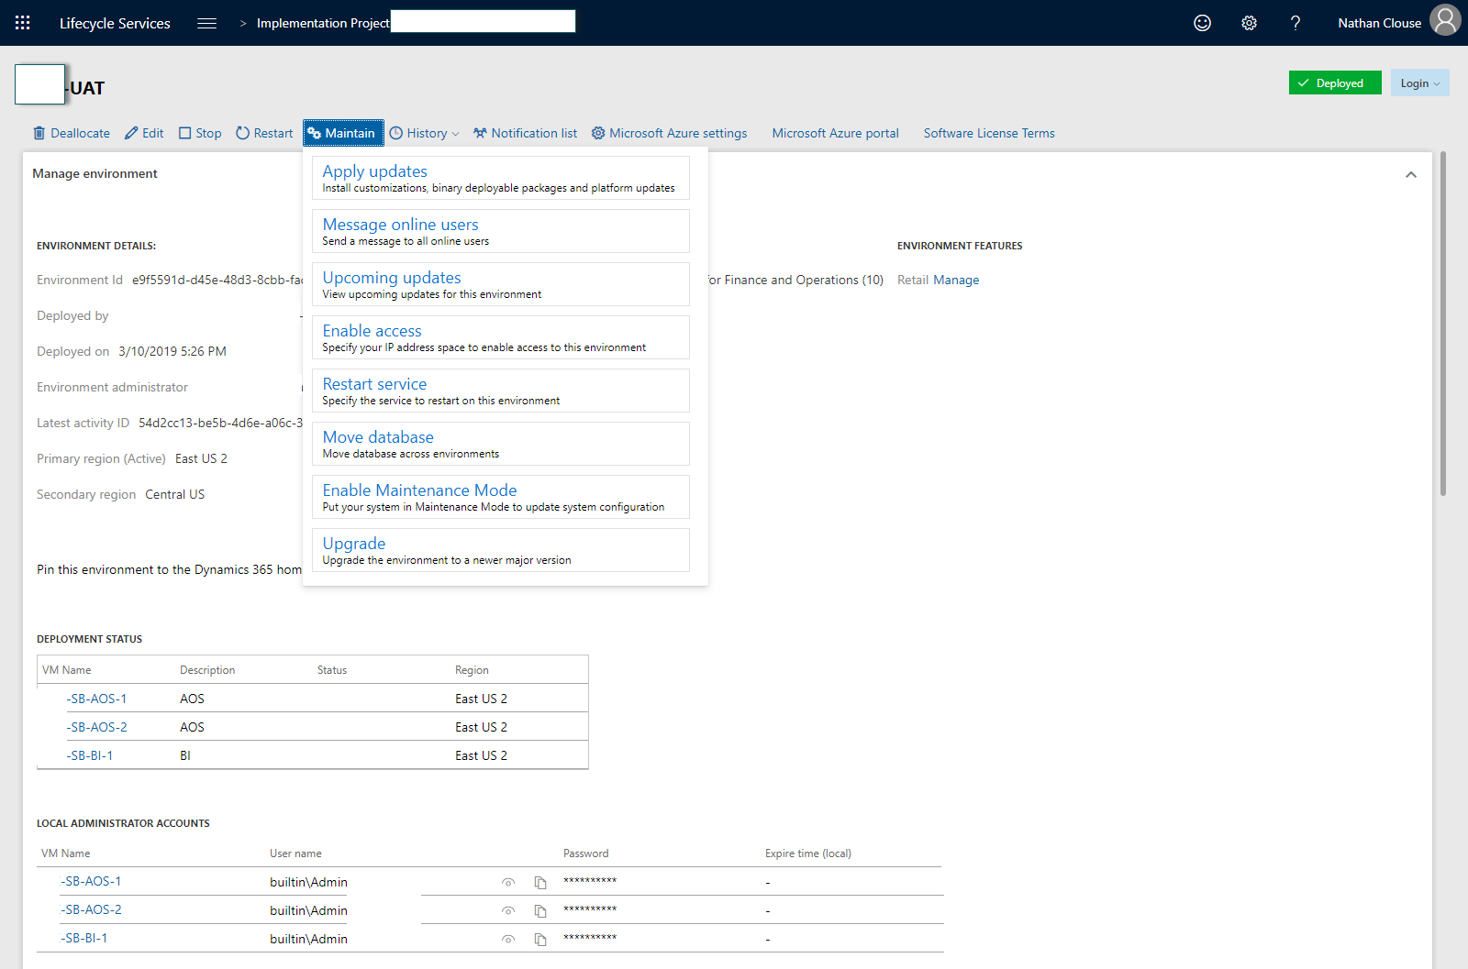

Slide 31
Operations
Apply Updates
This is where you can apply various deployable packages. These could be custom code, from an ISV or from Microsoft.
Messages Online users
This will let you display a message to users who are active in the system. Typically, this is used to broadcast a system downtime message for people who are still active.
View Scheduled Updates
Self-explanatory. You can see what is scheduled and when. If you wish to change the schedule, go to the hamburger > project settings > update sessions

Slide 32
Apply Updates

Slide 33
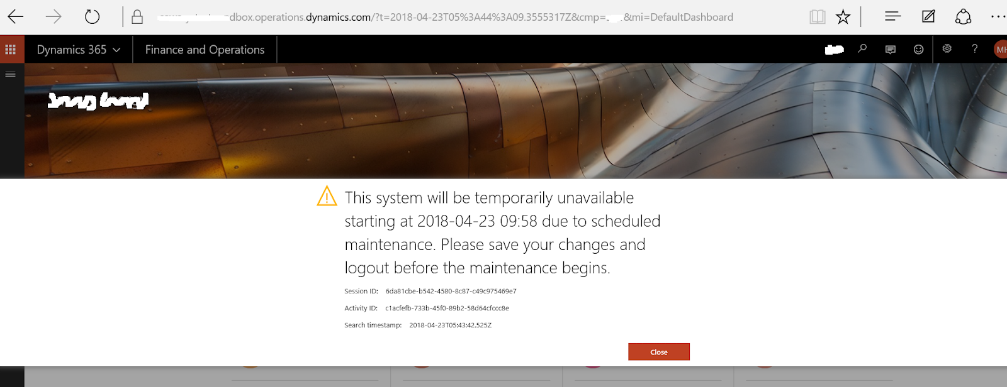
Message Online Users

Slide 34
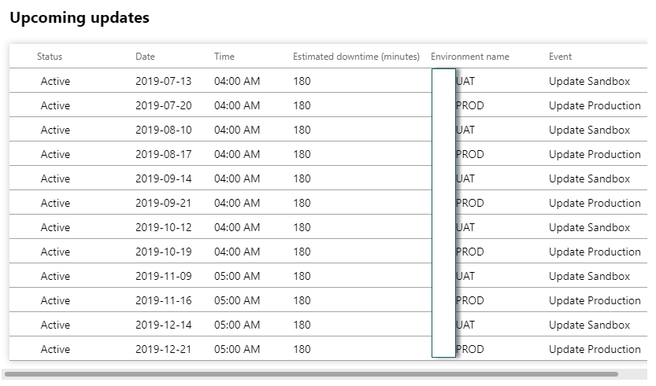
Upcoming Updates

Slide 35
Operations (cont.)
Enable Access
This is where you will enable access to RDP to the various servers. This is an interface the change the firewall rules for the servers in that environment.
Restart Services
Here you’ll be able to start 1 of the following: Batch, DIXF, Reporting Server, LCS Diagnostics, IIS
Move Databases
Several Options

Slide 36
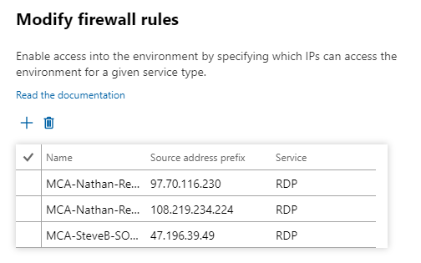
Enable Access

Slide 37
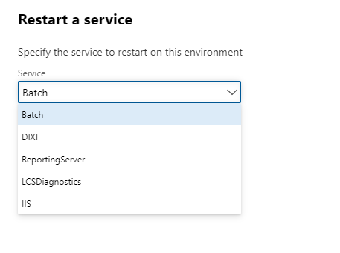
Restart Service

Slide 38
Operations – Move Databases
Refresh Database
A database refresh lets you copy the transactional and financial reporting databases of your production environment into the target, sandbox UAT environment. If you have another sandbox environment, you can also copy the databases from that environment to your target, sandbox UAT environment.
Import Database
Import a database into a standard environment from the asset library
Export Database
Export database from a standard environment to the asset library

Slide 39
Operations – Move Databases (cont.)
Point-in-Time restore Prod to Sandbox
allows you to restore to a sandbox user acceptance testing (UAT) environment from a backup of production not in the asset library.
Point-in-Time restore
Allows you to restore a database for the given environment from a backup for that environment that is not hosted in the asset library.

Slide 40
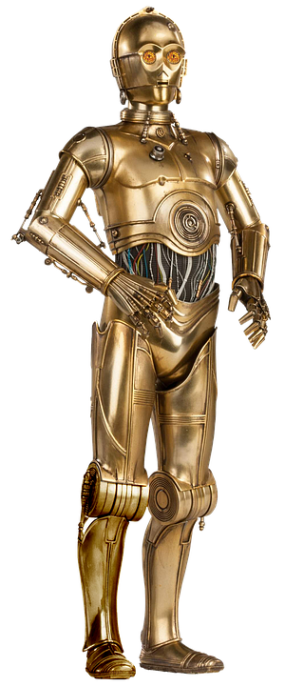
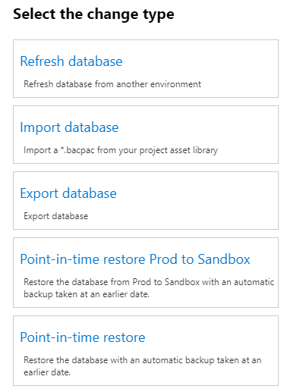
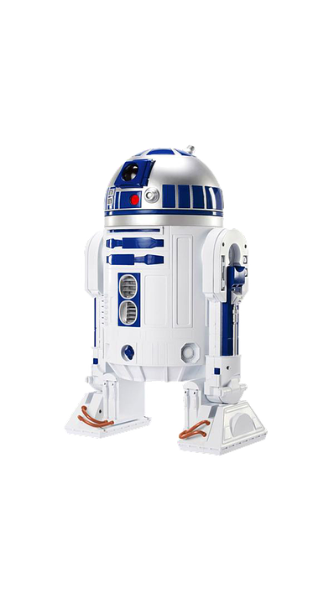
Move Database
Notes:
What is the Wookiee's home world, and how do you pronounce it? Kashyyyk -- pronounced "kah-SHEEK".

Slide 41
Operations (cont.)
Enable Maintenance Mode
Enabled maintenance mode for allow for specific configurations and processes to complete that may drastically alter the functionality of the system.
Upgrade
Only applicable to 7.3 environments or lower, basically N/A at this point.
Rotate Secrets
Tier 1 only - this means to regenerate and assign new certificates for the instance.
Notes:
Enable Maintenance Mode
Enabled maintenance mode for allow for specific configurations and processes to complete that may drastically alter the functionality of the system. For instance, enabling account structures. Only enable on request and disable once complete.
Upgrade
Only applicable to 7.3 environments or lower, basically N/A at this point.
Rotate Secrets
Only applies to cloud hosted environments as the other types have their certificates managed by MSFT. This means to regenerate and assign new certificates for the instance.

Slide 42
Servicing by Type – Non-Prod
Standard / Add-on
Largely Self Service now
On MSFT’s Azure subscription
Can stop / deallocate if you wish
Cloud-Hosted
Similar to Standard / Add-on but reduced overall LCS functionality
Can stop / deallocate from LCS
VHD
Servicing is entirely manual via command line
Download from LCS update via scripts
Notes:
By Type
Standard and Add-On
Largely self service now. You can Deallocate and stop the environment if you wish. Standard environments are on MSFT’s subscription which is paid for by your licensing so there is no cost benefit to stopping environments. You can also apply updates, such as new code or updates from MSFT, message online users, view scheduled upcoming updated, if any, enabled RDP access by IP whitelist, restart various services, move databases, enabled maintenance and upgrade major version.
Cloud Hosted
Similar to standard but you can only apply updates, message online users and also rotate secrets
VHD
Servicing is all manual doing via command line. Code is installed manually and/or synced from Azure DevOps. Platform Updates are downloaded locally and installed via command line. Community module available to assist with this if needed – D365 Tools.

Slide 43
Servicing by Type - Prod
Production / Operations
All actions available as service requests
Fulfilled by DSE
Most commonly you would request a code deploy or a database operation

Slide 44
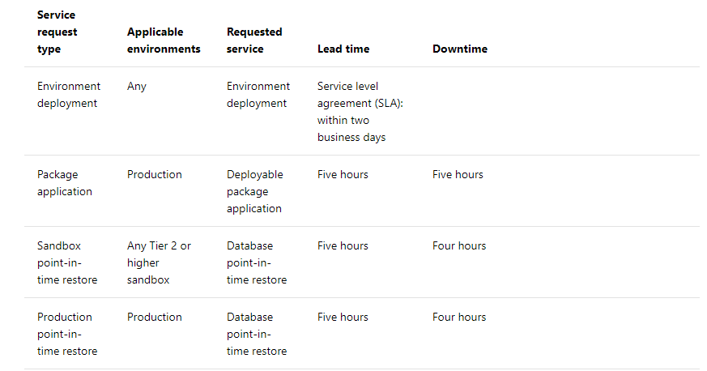
Servicing by Type – Prod (cont.)
Notes:
https://docs.microsoft.com/en-us/dynamics365/unified-operations/dev-itpro/lifecycle-services/submit-request-dynamics-service-engineering-team#service-request-types-and-slas

Slide 45
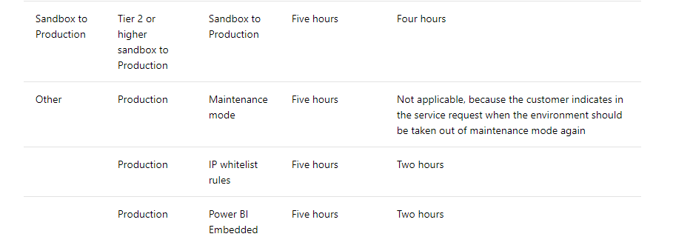
Servicing by Type – Prod (cont.)

Slide 46
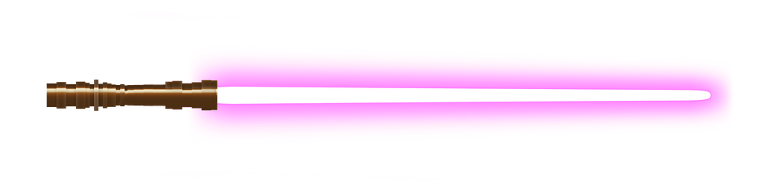
Tear Down: Non-Prod
Cloud-Hosted
Deallocate then delete. All data are lost and all resources in VM resource group are deleted including resource group
Standard / Add-On
Deallocate then delete. Can re-provision once delete is complete. Slot remains if unused

Slide 47

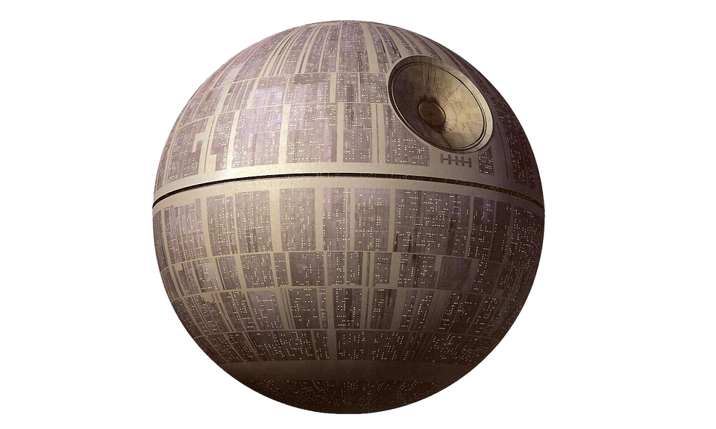
Teardown: Production
Nope
Entirely Managed by MSFT

Slide 48
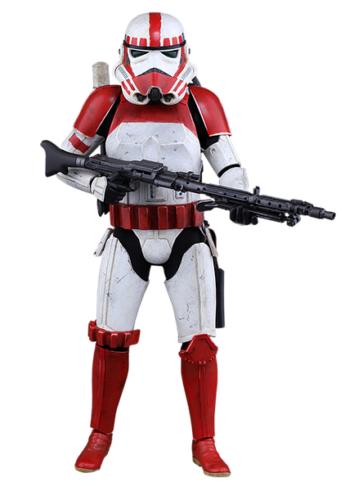
Resizing
Cloud-Hosted
Resize the VM
LCS may not reflect the state of the VM
Standard / Add-On
For non-production, delete and re-provision
For Prod, create a request to re-evaluate usage based on licenses, increased functionality or seasonality
Notes:
What does AT-AT stand for? All Terrain Armored Transport.

Slide 49
Analytics, Diagnostics and Environment Monitoring

Slide 50
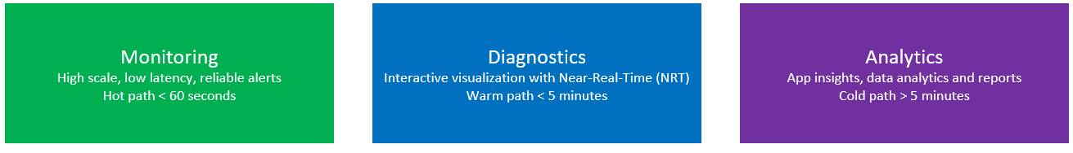

Slide 51
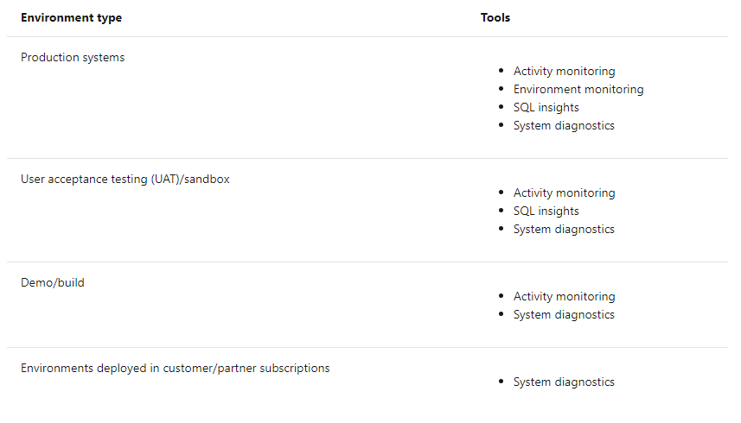

Slide 52
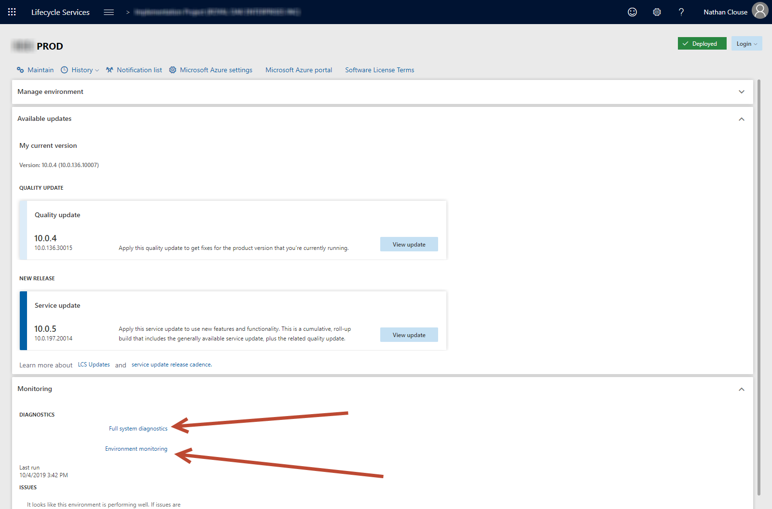
Where to Find It - PROD

Slide 53
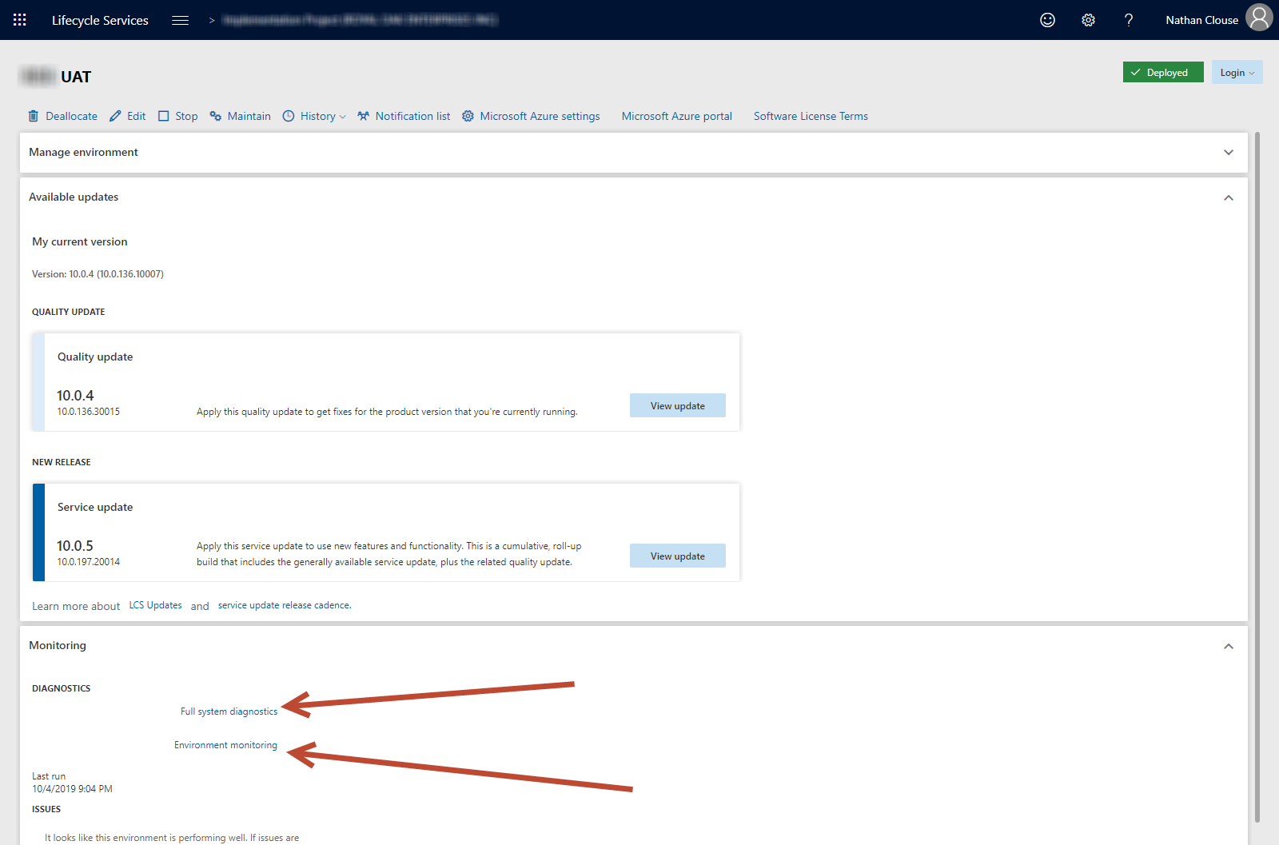
Where to Find It - UAT

Slide 54
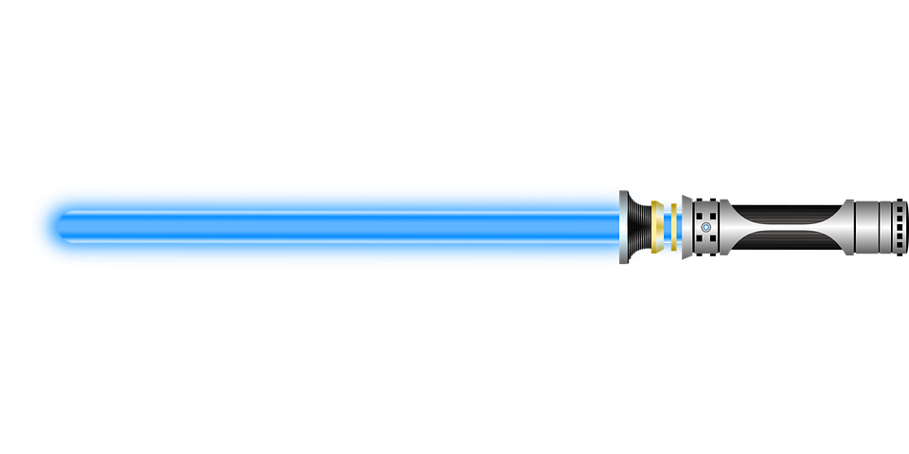
System Diagnostics
Available in UAT / Sandbox environments plus PROD
Reports Server info
Failed jobs
Detected issues
High level overview of an environment

Slide 55
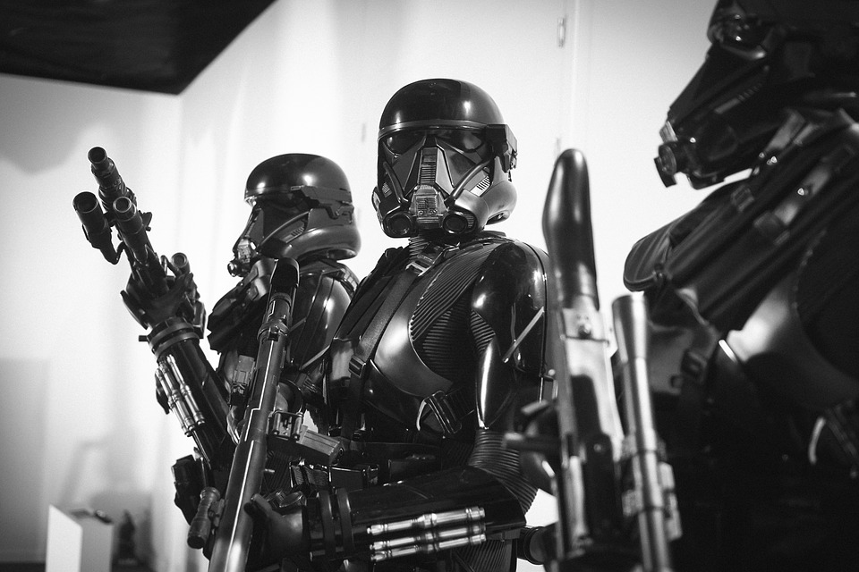
Environment Monitoring
Available in Prod and UAT only
High Scale, low latency
“hot path”
What’s going on right now
User Interaction
User load
Activity Load
SQL Insights
Review SQL level activity
Rebuild / create indexes
Review load and usage
Notes:
The User interaction chart shows a user's activities on various machines in the environment and the SQL utilization trend.
The User load section shows all the system users. Each chart shows the time that the user spent on a specific machine.
The Activity load section shows the activities that were performed on each machine. If you hover over an activity, you see the Form:Control:Action as a tuple. For example, if you look at LedgerJournal:New:Click in this section, you can see that user A opened the LedgerJournals page and selected the New button to create a new journal entry.
The User activity grid shows the various activities that users performed, based on their session timestamp.

Slide 56
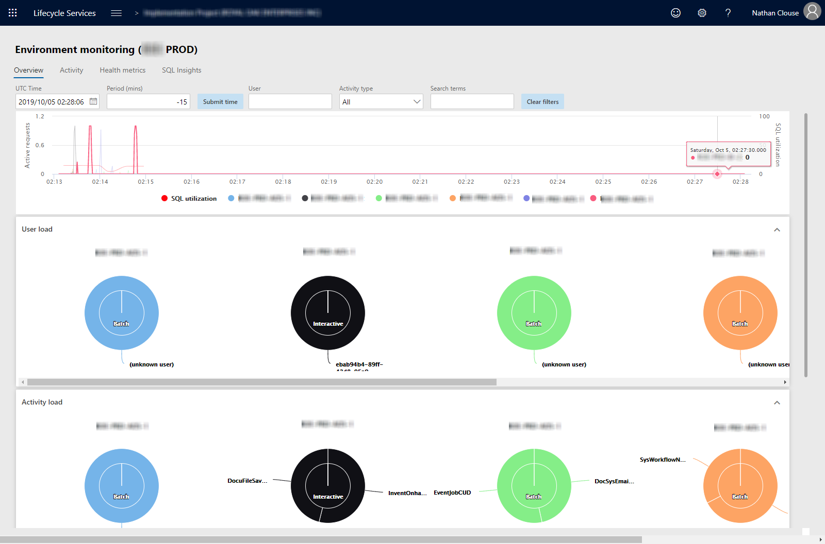
Overview – 10 PM Friday Night

Slide 57
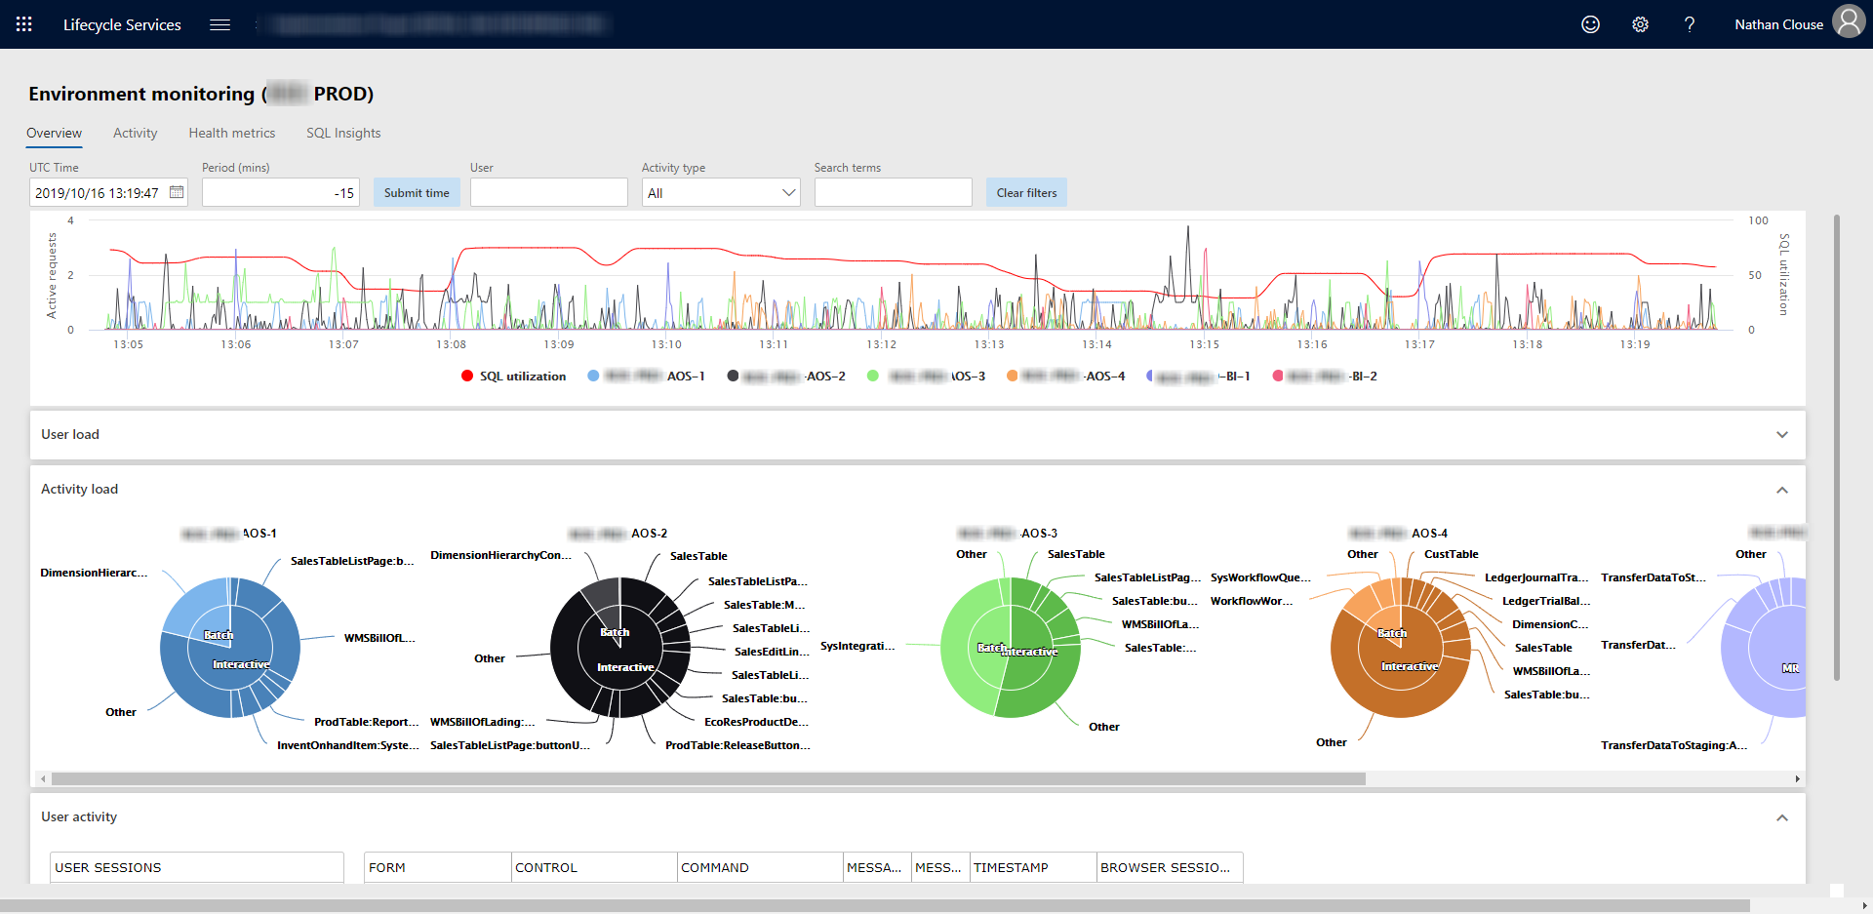
Overview – 10 AM Monday Morning

Slide 58
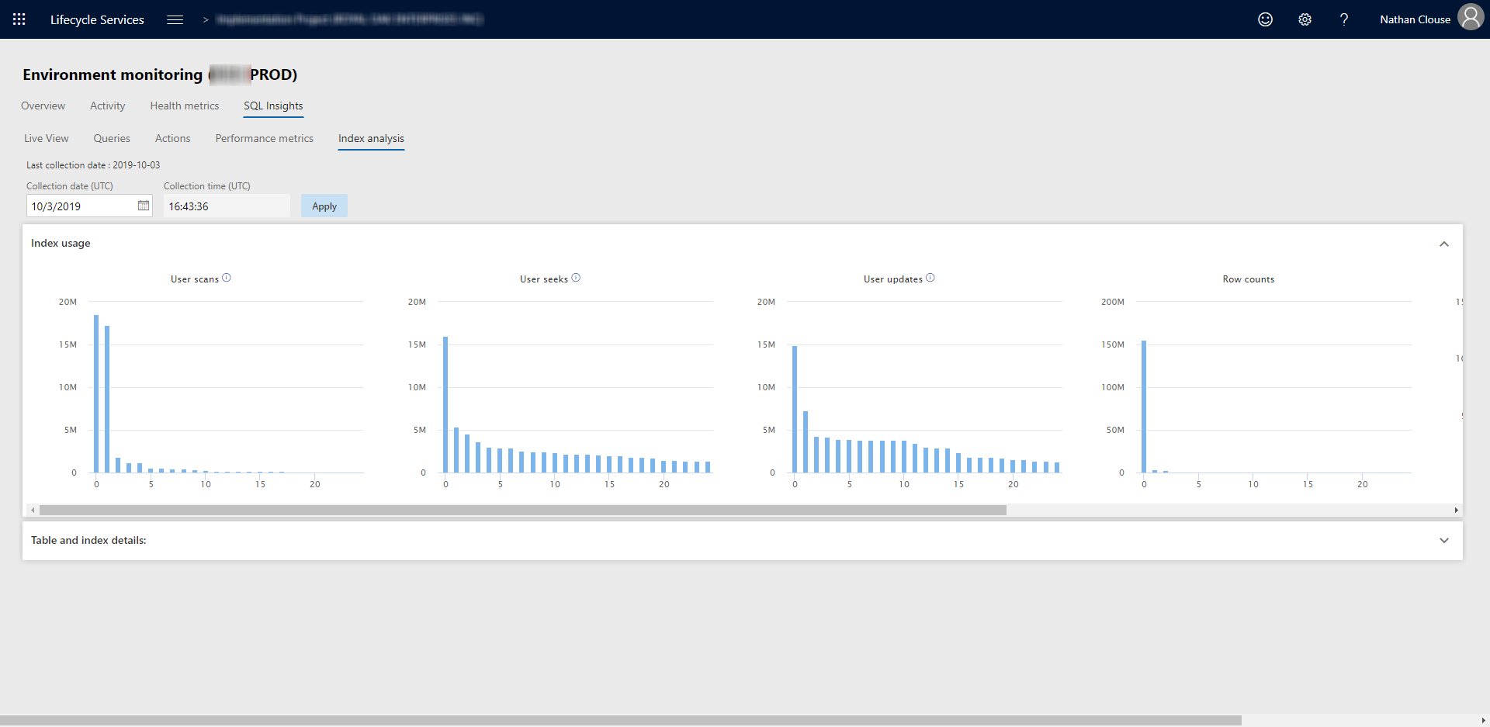
Index Analysis

Slide 59
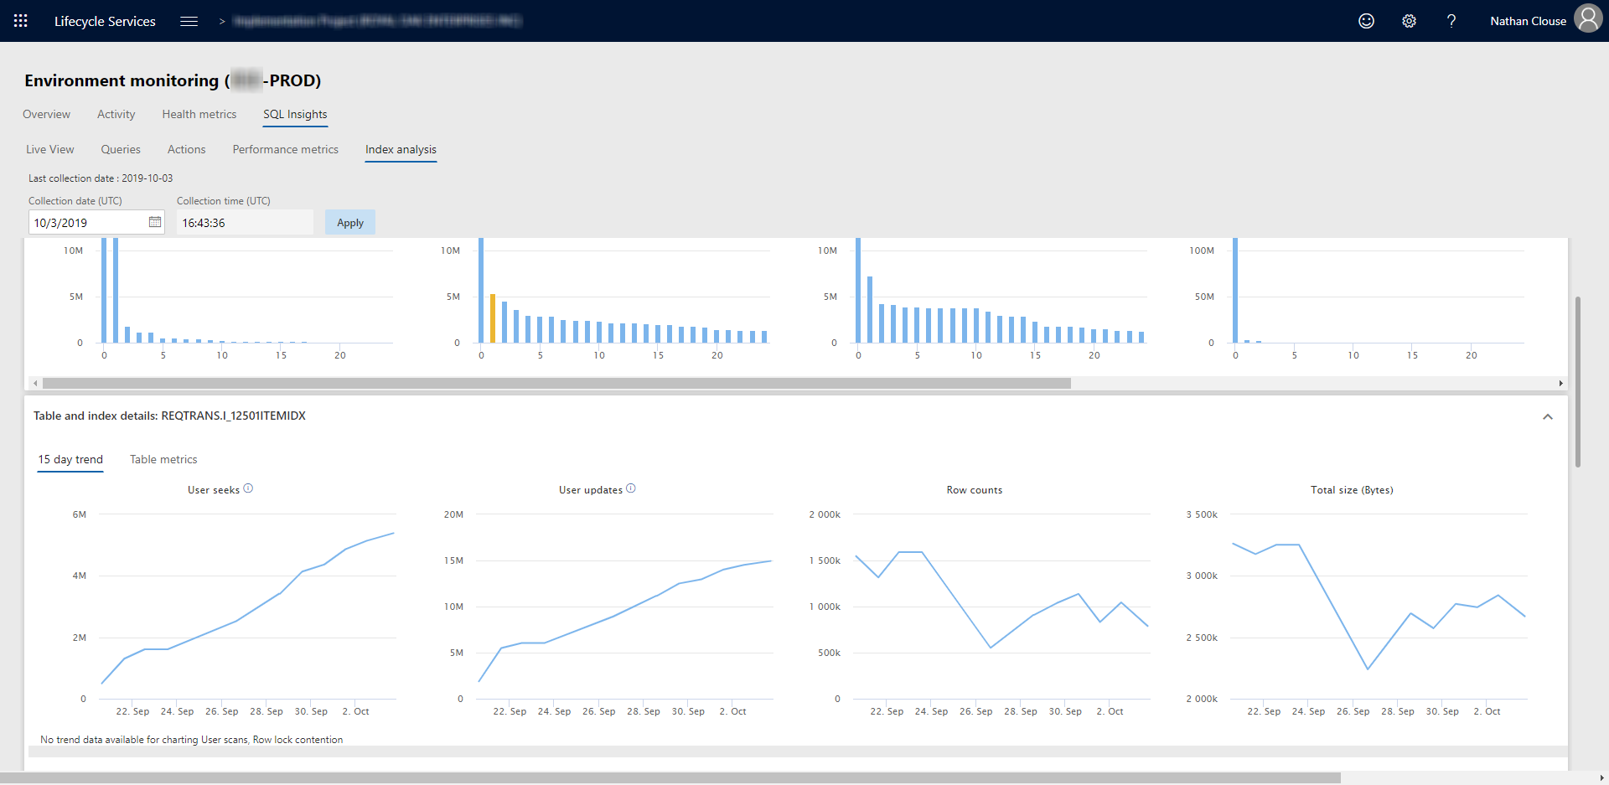
Index Analysis - Details

Slide 60
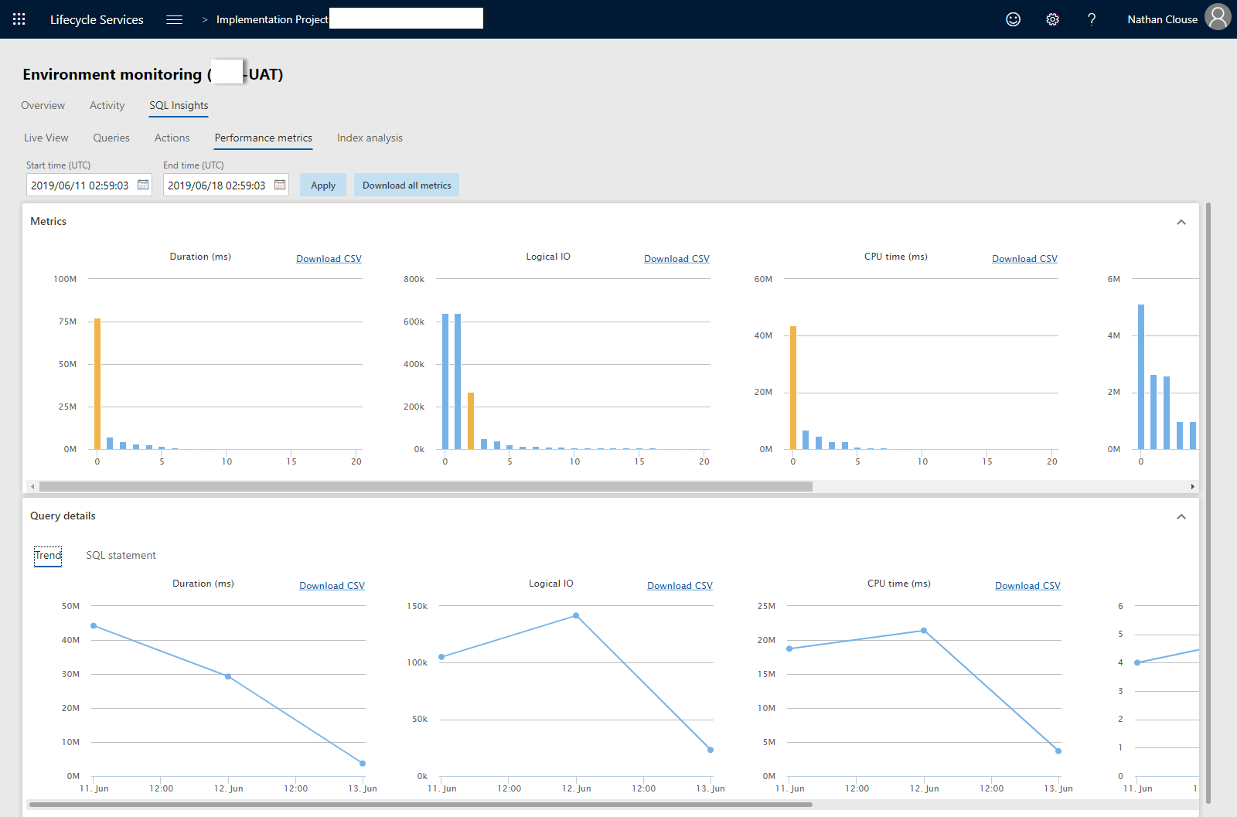
Performance Metrics

Slide 61
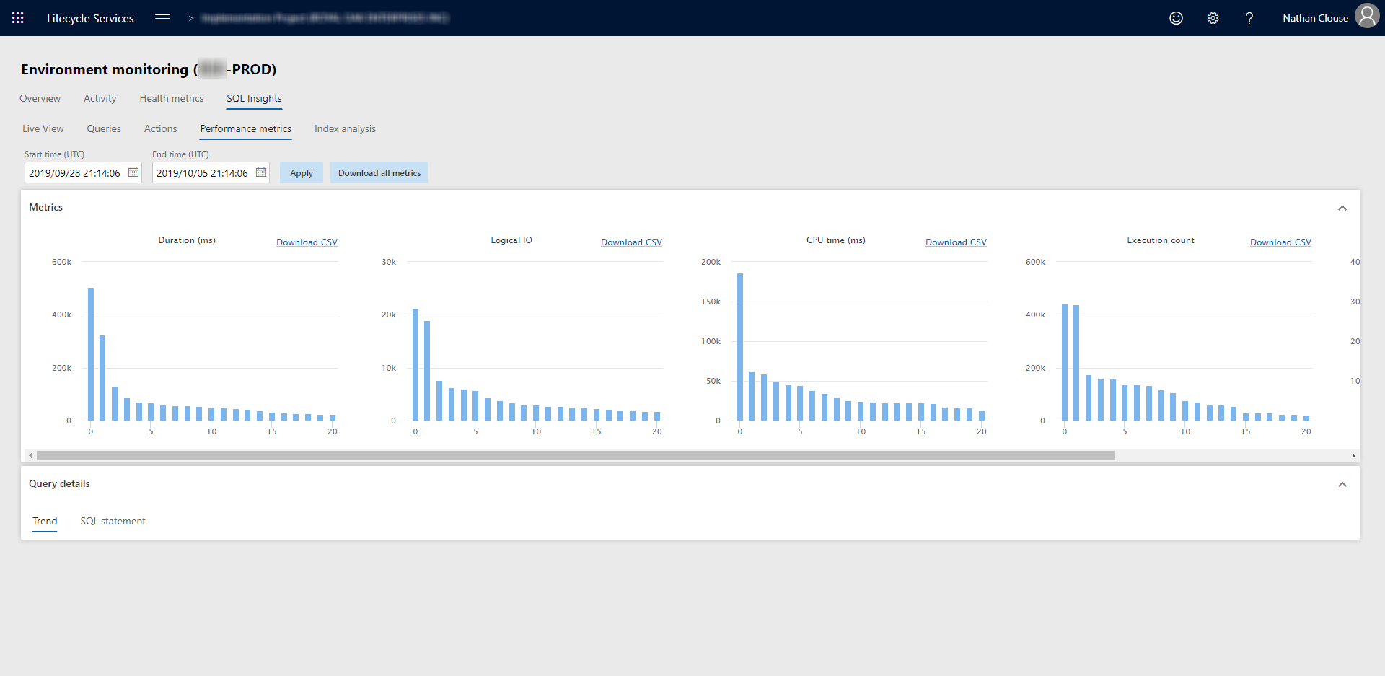
Performance Metrics - Again

Slide 62
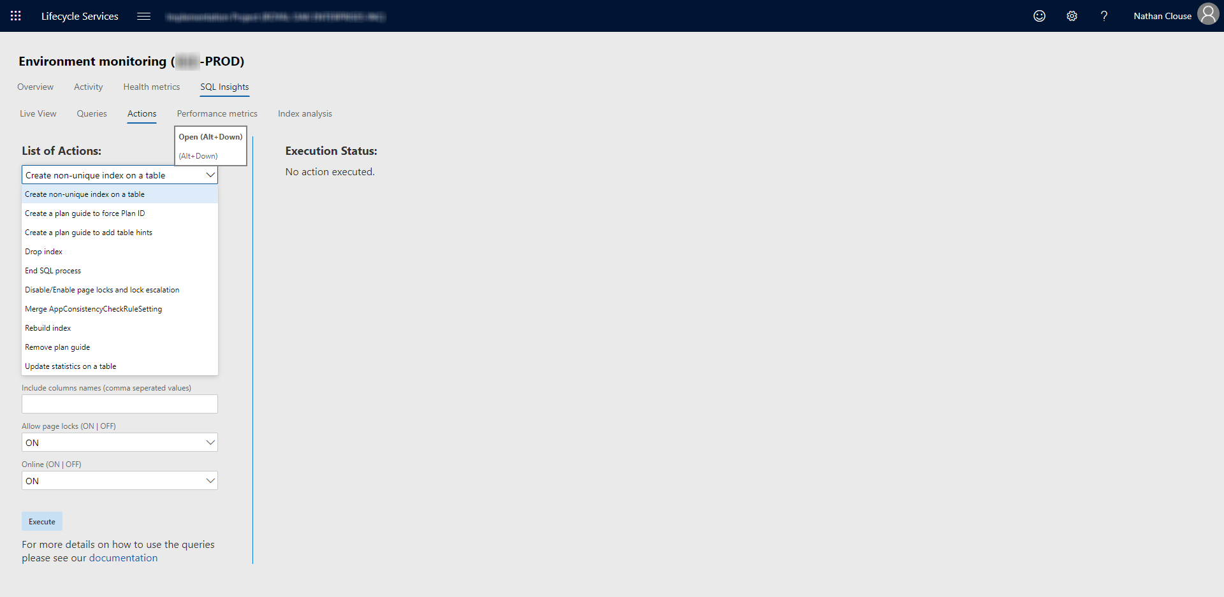
(SQL) Actions

Slide 63
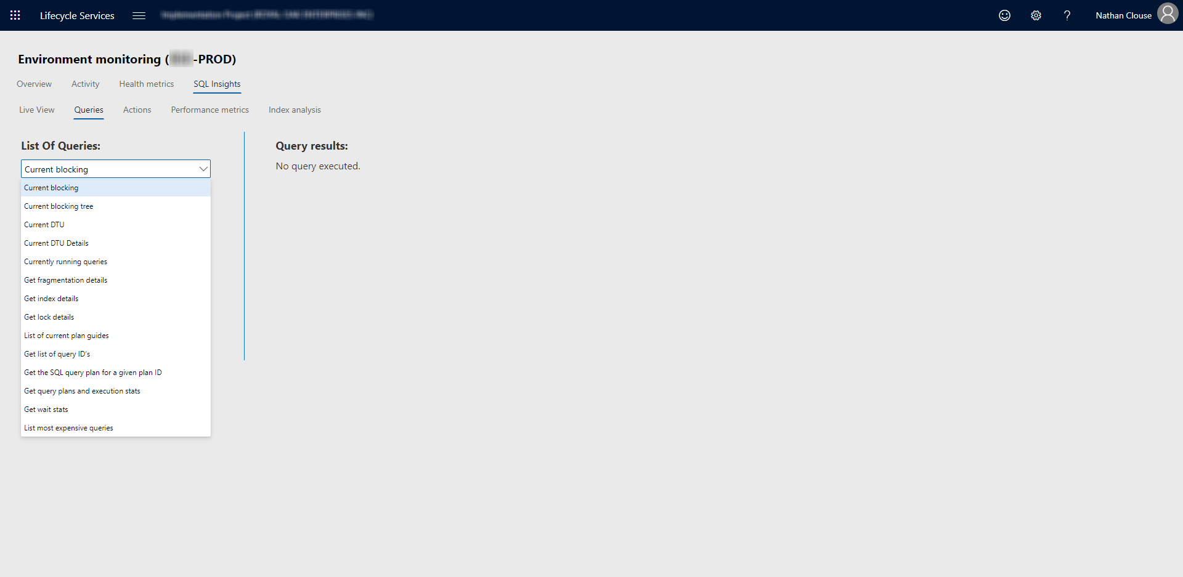
Queries

Slide 64
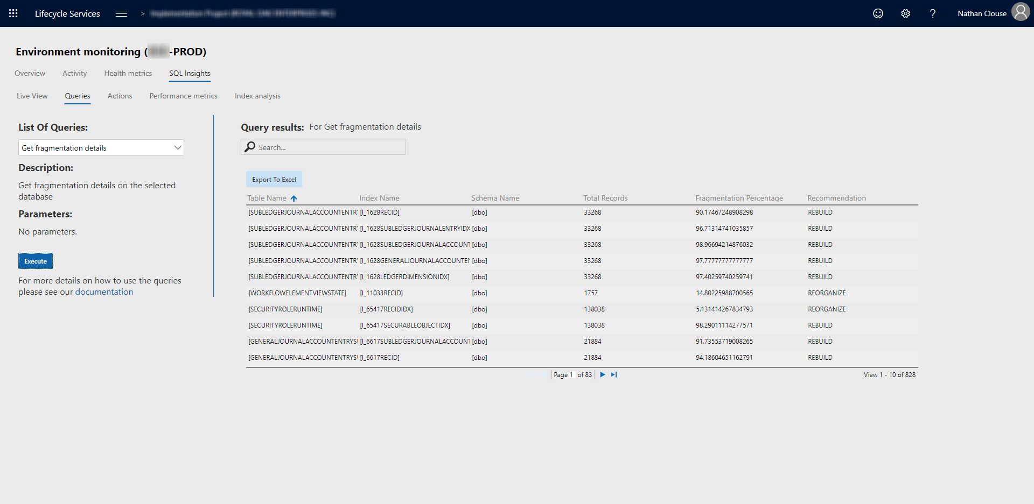
Queries - Fragmentation

Slide 65
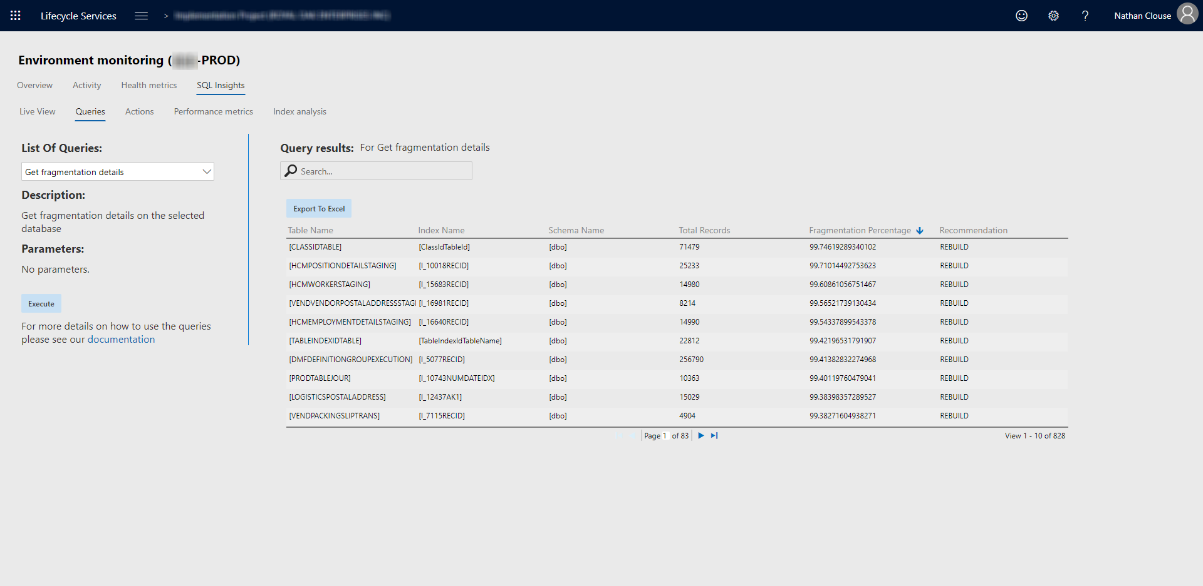
Queries – Fragmentation

Slide 66
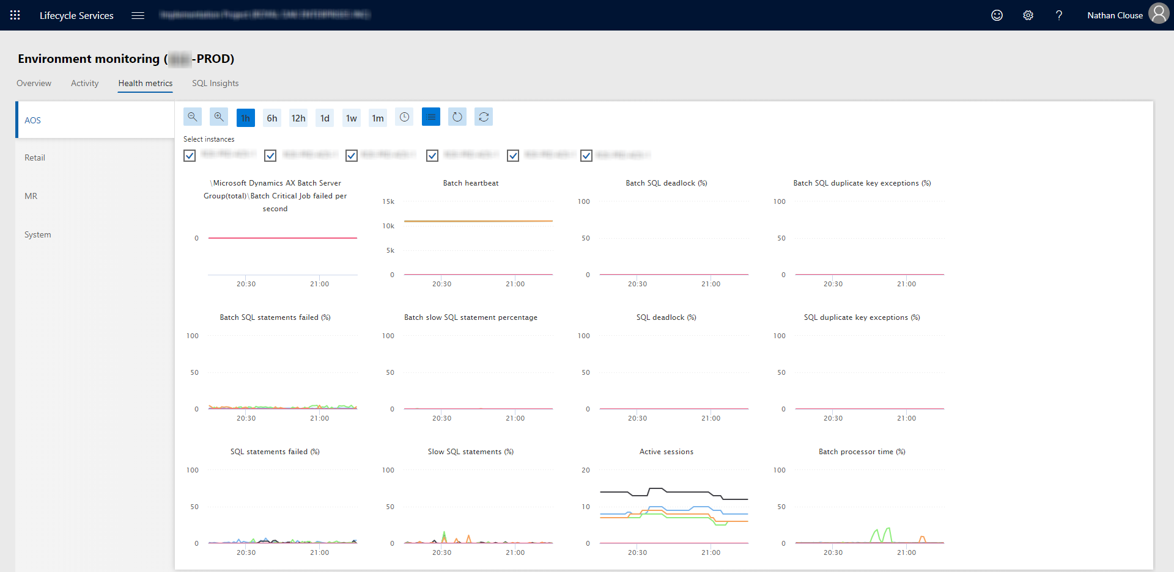
Health Metrics

Slide 67
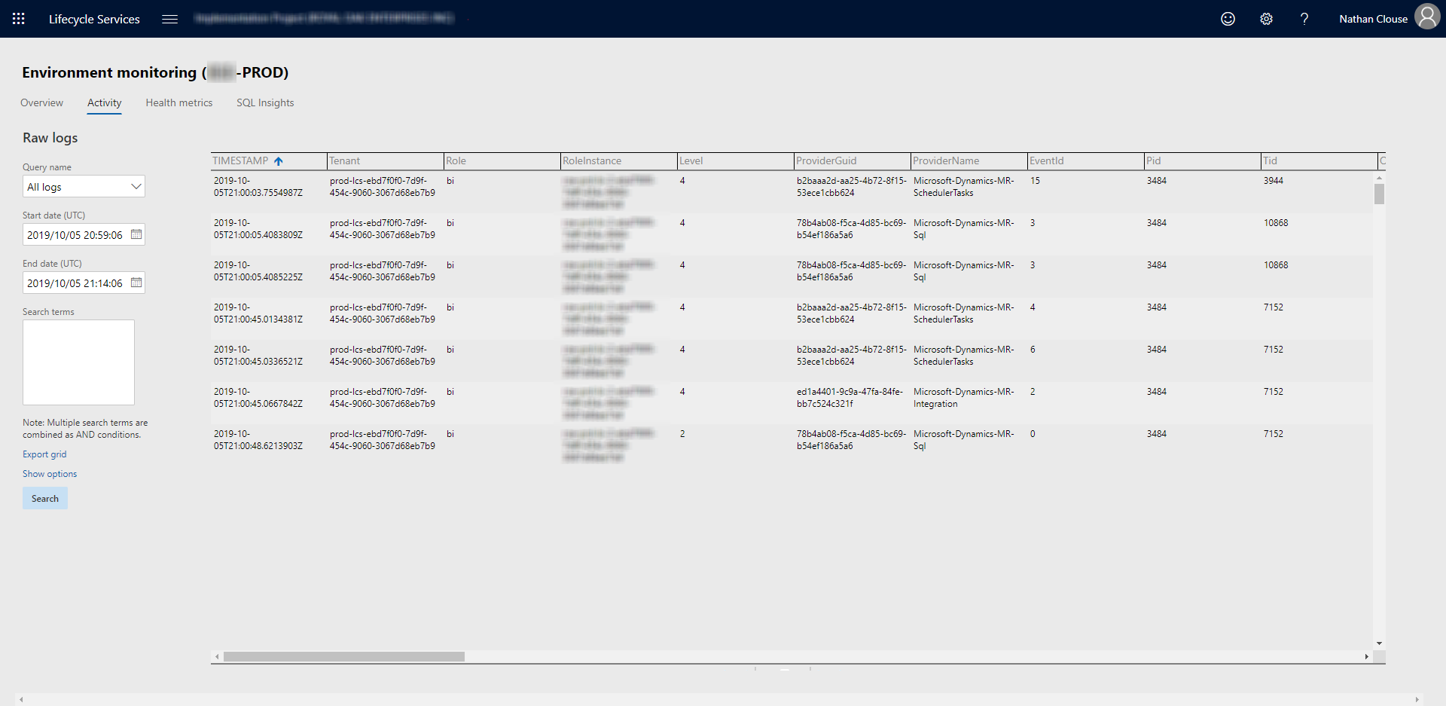
Activity

Slide 68

Questions?

Slide 69
Please Let Us Know Your Feedback
We want to hear what you think even if you think I’m terrible but want to be polite about it.
Image Credits: https://pixabay.com/, https://www.microsoft.com/en-us/, https://twitter.com/

Slide 70

Thank you! Please Complete The Survey!
https://www.linkedin.com/in/nathanclouseax/
https://twitter.com/NathanClouseAX
http://www.atomicax.com/
https://github.com/NathanClouseAX/
Nathan.Clouse@MCAConnect.com
Nathan Clouse
Technical Solution Architect
MCA Connect, LLC
AXUG Summit Track Leader
Nathan.clouse@mcaconnect.com
www.atomicax.com
@NathanClouseAX

